Slide 1
CS 447/647
Pluggable Authentication Modules

Slide 2
Goals
What is the purpose of PAM?
What are the four PAM control types?
How are PAM variables passed into libpam-script scripts?
What is the data structure used by PAM modules?

Slide 3
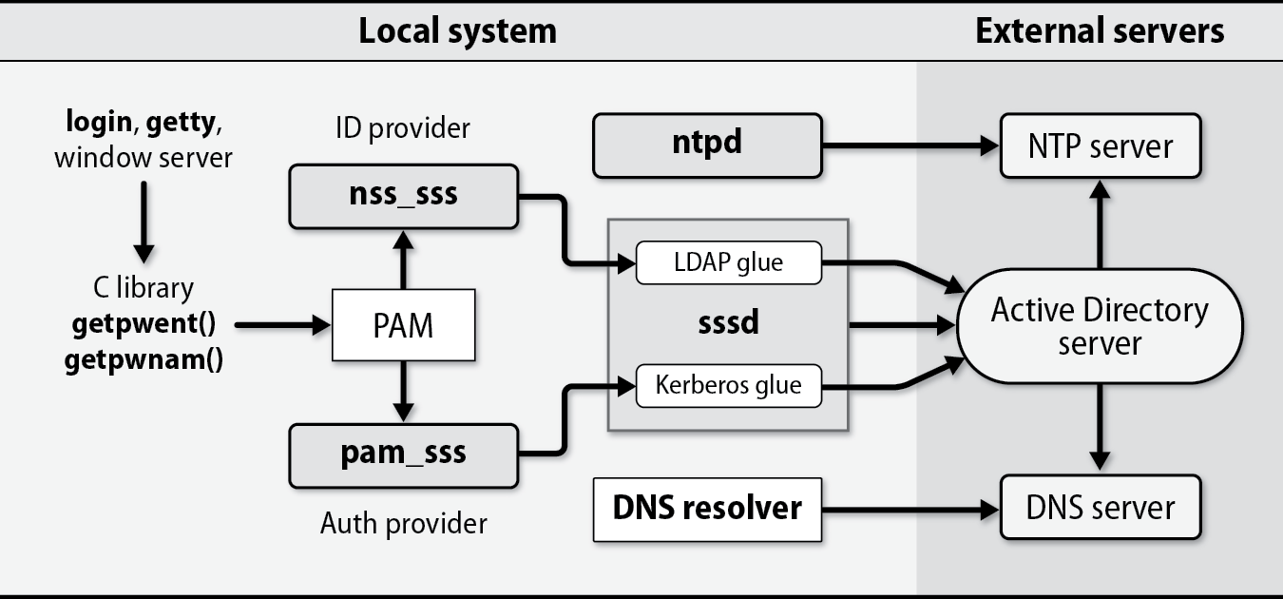

Slide 4
Pluggable Authentication Modules (PAM)
Provides an interface for authentication
login(1) utility calls the PAM libraries
Iterates over a stack composed of modules
Configurations in /etc/pam.d/*
“You can choose to have no security or absolute security (no access permitted).”
Errs toward the latter
Configuration errors will lock you out.

Slide 5
Pluggable Authentication Modules (PAM)
Four separate types of (management) module-type
Authentication
Account
Session
Password
man pam.conf

Slide 6
Authentication
Instructs application to prompt for username and password
Verifies access credentials
pam_unix.so checks /etc/passwd and /etc/shadow

Slide 7
Account
Non-authentication based account management
Restrict/permit access to a service based on
Time of day
Resources available
Location of a user

Slide 8
Session
“Does things” before/after a user can be given service
Logging
Mounting filesystems

Slide 9
Password
Used for changing and manipulating passwords.

Slide 10
Example
module-type control-flag module-path [arguments]
Add:
auth optional pam_warn.so
To:
/etc/pam.d/common-auth
Exit and log back-in
tail -n20 /var/log/auth.log

Slide 11
Absolute security
# # default; deny access #
other auth required pam_deny.so other account required pam_deny.so other password required pam_deny.so other session required pam_deny.so
Notes:
Bad for productivity

Slide 12
¯\_(ツ)_/¯
# # default; any access #
other auth required pam_permit.so other account required pam_permit.so other password required pam_permit.so other session required pam_permit.so
#This module is very dangerous. It should be used with extreme caution. man 8 pam_permit

Slide 13
Modules
pam_access - Provides access management
pam_unix - Authenticate against /etc files
pam_env - Control environmental variables
pam_systemd - Registers sessions in systemd hierarchy
pam_ldap - LDAP authentication
pam_sss - SSS authentication
pam_permit - Always allows access
pam_listfile - Allows you to authenticate based on lines in a file
Notes:
System Security Services daemon (SSSD)

Slide 14
module-type control-flag module-path [arguments]
module-type
auth - Identify user and grant permissions
account - enforces restrictions
session - tasks before login
password - changing a password
control-flag
include - Includes another file
optional - Only important if the only module
required - Failure eventually causes stack to fail
requisite - Same as required but stack fails immediately
sufficient - Exits upon success but does not override
module-path (/lib/x86_64-linux-gnu/security)
pam_unix.so - Unix file authentication Local
pam_ldap.so - LDAP authentication Network
pam_krb5.so - Kerberos Authentication Network pam_sss.so - SSSD authentication Network

Slide 15
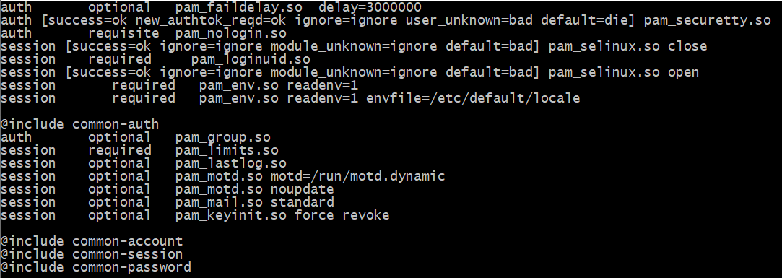
Notes:
nullok_secure
The default action of this module is to not permit the user access to a service if their official password is blank. The nullok_secure argument overrides this default and allows any user with a blank password to access the service as long as the value of PAM_TTY is set to one of the values found in /etc/securetty.
try_first_pass
Before prompting the user for their password, the module first tries the previous stacked module's password in case that satisfies this module as well.
use_first_pass
The argument use_first_pass forces the module to use a previous stacked modules password and will never prompt the user - if no password is available or the password is not appropriate, the user will be denied access.

Slide 16
Syntax [value1=action1 value2=action2 ...]
Values
success
open_err
symbol_err
service_err
system_err
buf_err
perm_denied
abort default ...
Actions
ignore - will not contribute to return
bad - module failed
die - same as bad but immediately exits
ok - PAM_SUCCESS
done - Terminate the stack and return N - Same as OK but skips N modules reset - clear all memory and start with next
module

Slide 17
Handling authentication
apt install libpam-script libpam-mkhomedir
pam-auth-update #Friendly
vim|emacs|nano /etc/pam.d/common-auth

Slide 18
libpam-script
Invoke scripts within the PAM stack
Authentication
Passwd changes
Session opening
Session closing
Scripts stored in /usr/share/libpam-script

Slide 19
libpam-script scripts
pam_script_auth - Authentication
pam_script_acct - Account
pam_script_passwd - Password changes
pam_script_ses_open - Session open
pam_script_ses_close - Session close

Slide 20
pam_script_auth
/usr/share/libpam-script/pam_script_auth
#!/usr/bin/env python3 import os import sys print(“PAM Script Start”) for k, v in os.environ.items(): print(“{0}, {1}”.format(k, v)) print(“PAM Script End”)
sys.exit(0)

Slide 21
PAM
/run/pwchk
uid: greater than 0
pam_script_auth
/etc/pam.d/nginx_pwchk
uid: 0
pwchk.py
/etc/pam.d/login #or
user:password
auth optional pam_warn.so
auth [success=1 default=ignore] pam_script.so dir=/usr/local/pam
auth requisite pam_deny.so
auth required pam_permit.so
auth optional pam_warn.so
auth [success=1 default=ignore] pam_unix.so
auth requisite pam_deny.so
auth required pam_permit.so
True or False
socket 0666 rw-rw-rw
Notes:
curl -u 'student166:qwerty' http://localhost/secure/test.txt -v
import base64
base64.b64encode(b"student166:qwerty")

